Slide 1
Predicate Logic The Rules of Inference
Mirko Farina
Assistant Professor
Innopolis University
* I do not claim authorship for all texts and pictures in the presentation.

Slide 2

Previous Lecture
Truth Tables for Basic Arguments
Introduction to Predicate Logic
And Differences between Propositional and Predicate Logic
3. Symbols and Translation in Predicate Logic
2

Slide 3





Exercises (Truth Tables)
If there is ice cream, then I will drink coffee
If there is a donut, then I will drink coffee
There is no ice cream and there is a donut
Therefore I drink coffee
3

Slide 4







Exercises
4

Slide 5




















Truth Table
5

Slide 6




Slide 7








Slide 8



THINGS TO REMEMBER
1 x, y, z are reserved variables (do not use them)
2. Existential and Universal quantifiers
3. All other letters can be used
6

Slide 9

When we have a propositional statement
Grass is yellow.
We take the predicate capitalizing it, and then taking the subject and making it lower case and putting it next to the predicate
We also learned how to use the universal and existential quantifiers. So, we learned how we can translate and assess universal and particular propositions into predicate logic
7

Slide 10








Easy practise
Some grapes are sour
Tigers exist
8

Slide 11















All Ripe Apples are crunchy and delicious
Some Apples are green and tasty
9

Slide 12










Peaches are edible unless rotten
10

Slide 13


Today’s Plan
We will look at how to use the rules of the inference within predicate logic.
BACKGROUND INFO NEEDED WHICH WE DON T HAVE TIME TO EXPLAIN IN THIS LECTURE: https://www.tutorialspoint.com/rules-of-inference-for-predicate-calculus
Universal generalization
Universal instantiation
Existential generalization
Existential instantiation
11

Slide 14











IMAGINE THIS CASE
What if I had fx and tx bounded both bounded to the quantifier?
12

Slide 15





13

Slide 16







So to overcome this problem in this lecture we are going to add some tools, 4 new rules,
We basically need to either generalise or instantiate quantifiers
14

Slide 17






















1. Let s start with the first rule
Universal Instantiation
15

Slide 18







All philosophers are speculators
Hegel is a philosopher
Thus, Hegel is a speculator
16

Slide 19

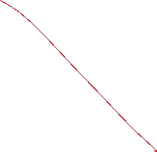

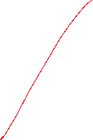





2. Universal Generalization
Generalization add quantifiers. If I have a function y I can generalise it to
17

Slide 20
















Example
All psychiatrists are doctors
All doctors are college graduates
Therefore all psychiatrists are college graduates
18

Slide 21
REMEMBER
Universal Generalization apply to variables not to constants!
19

Slide 22














3. Existential Generalization
If a have a predicate proposition that s not quantified I can existentially quantify it into
20

Slide 23















All clowns are scary persons
Jose is a clown
Therefore there is at least one scary person in the world
21

Slide 24













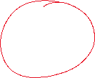


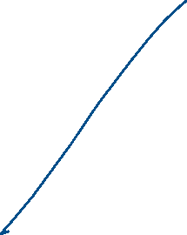
4. Existential Instantiation
You are going to remove the existential quantifier
RULES to move from Fx into Fa:
Every time you do an existential instantiation you
Introduce an existential name, the name must be new
Meaning it s not used in the previous line
AND
It can’t be in the conclusion,
22

Slide 25






All attorneys are college graduates
Some attorneys are golfers
Thus, some golfers are college graduates.
Define:
23

Slide 26











24

Slide 27










25

Slide 28



















26

